Slide 1
Build a Simple PVC Mason Bee / Leafcutter Bee Nesting House

Slide 2
4o nesting tubes fit nicely inside a 3 inch PVC pipe.
These are the nesting tubes I use. You can buy them at Crown Bees:
http://crownbees.com/shop/nesting-material/guard-tubes-and-inserts
They sell them in a quantity of 40 and that fills a 3 inch PVC pipe pretty well.

Slide 3
Pieces you will need to build nesting house.
You will need three 3 inch PVC end caps and about 2 feet of 3 inch PVC pipe.
If you buy a 4 foot piece of 3 inch PVC pipe you could make two of these.

Slide 4
Cut a 45 degree angle and make sure the short side is 8.5 inches long
Set your miter saw to cut a 45 degree angle.
Cut the 3 inch PVC pipe so the short side is 8.5 inches long.
If your miter saw does not cut all the way through you can finish with a saws-all or a hand saw.
If you are going to make two from a 4 foot piece of PVC pipe then plan your cut so you can make one angled cut and then make two straight cuts and get two angled pieces.
Make sure the short side of both pieces are 8.5 inches long

Slide 5
Make one piece 8.5 inches long with both ends cut straight
Make one (or two if needed) straight cuts to make a piece 8.5 inches long with both ends straight.
If you made the angled cut correctly you should have enough of a 4 foot pipe left to make two 8.5 inch pieces with both ends straight

Slide 6
Glue on the end caps on the right sides. Do Not Glue the one on the left!
Glue on the end caps on the right sides. You can use PVC glue or any glue that will work on PVC.
Just make sure the ends on the right seal out any light.
Do Not Glue the cap on the left! This one needs to be removable. In the fall you will put the nesting tubes in the top pipe for winter storage and release next spring.

Slide 7
Drill two small (5/32) holes for drainage
Drill two 5/32 inch holes for drainage in the short side of the angled pipe.
The long side will be up to protect the front from rain, but if any gets in, the drainage holes will help dry things out.

Slide 8
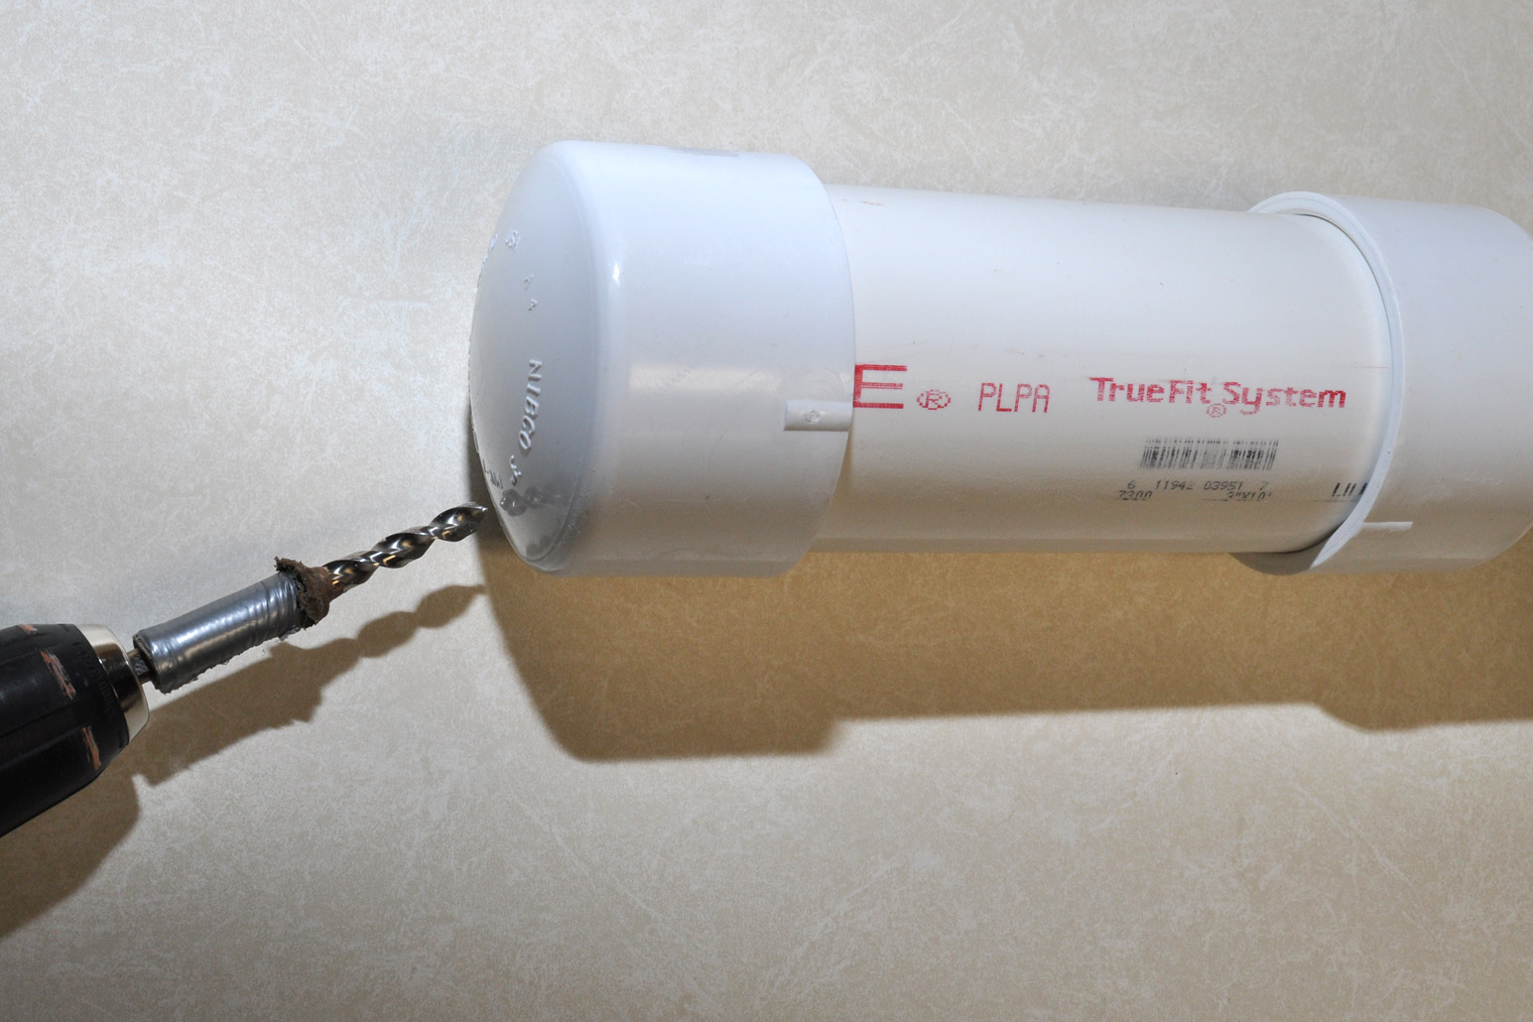
Drill one 5/16 inch hole
Drill one hole with a 5/16 inch drill bit in the end cap that is NOT GLUED to the straight pipe.
If you drill it on the under side at an angle it will help keep the rain out.
DO NOT drill drain holes in the straight pipe. You want just one light source (hole). This will make the bees more likely to stay near your nesting house and not fly away when they hatch in the spring.

Slide 9
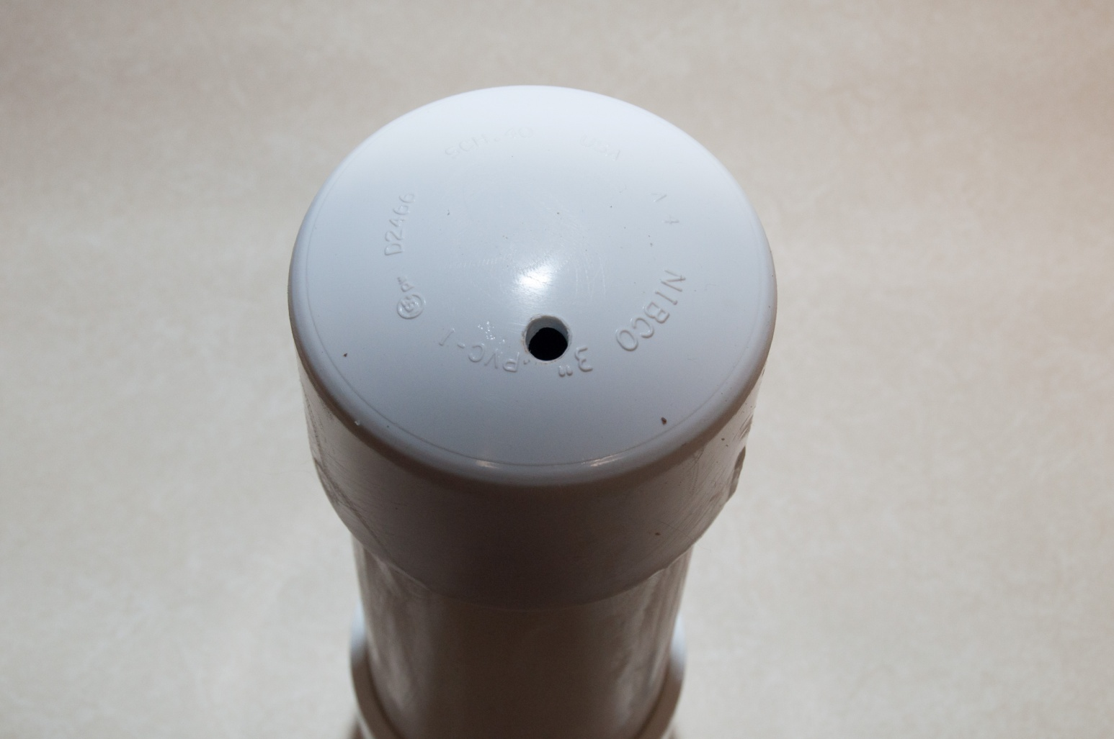
One 5/16 hole in the release tube
If you have bee cocoons or nesting tubes from last year, then put them in the straight pipe when you plan to release them in the spring.
That is why the end cap with the hole is not glued. So you can remove it, put in the cocoons or nesting tubes and then put the cap back on.
When the bees emerge they will see the one exit hole, just like in their natural nesting holes. This increases the chances they will not fly away looking for a better nesting site.

Slide 10
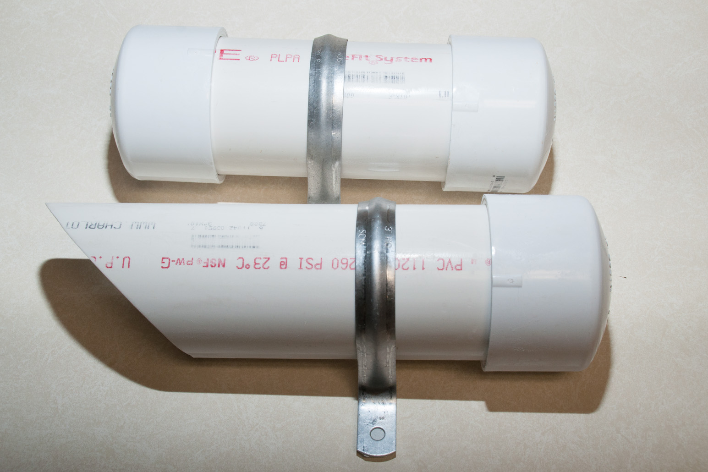
Add two metal straps
Add two metal straps to hole both pipes.
These can be found in the plumbing section with the PVC pipe.
Make sure you get the straps for 3 inch PVC pipe.
You can find these in copper. Copper looks a little nicer.
You can also paint the non-copper ones.

Slide 11
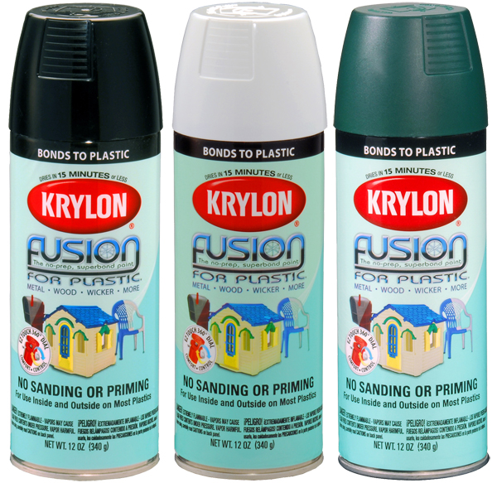
Krylon Fusion for Plastic spray paint
Paint with spray paint.
Make sure the paint you use is rated for plastic.
I have read the best paint to use on PVC is Krylon Fusion for Plastic.
You can buy it at Wal-Mart

Slide 12
Mount both pipes to a 1 by 3
Use screws to mount both pipes to a 1 inch by 3 inch by 18 inch cedar board (a three foot 1by3 cut in half). Then you can use screws to mount the board to the side of your house or garage.
You could also skip the board and just mount the tubes directly to the side of your house or garage.

Slide 13
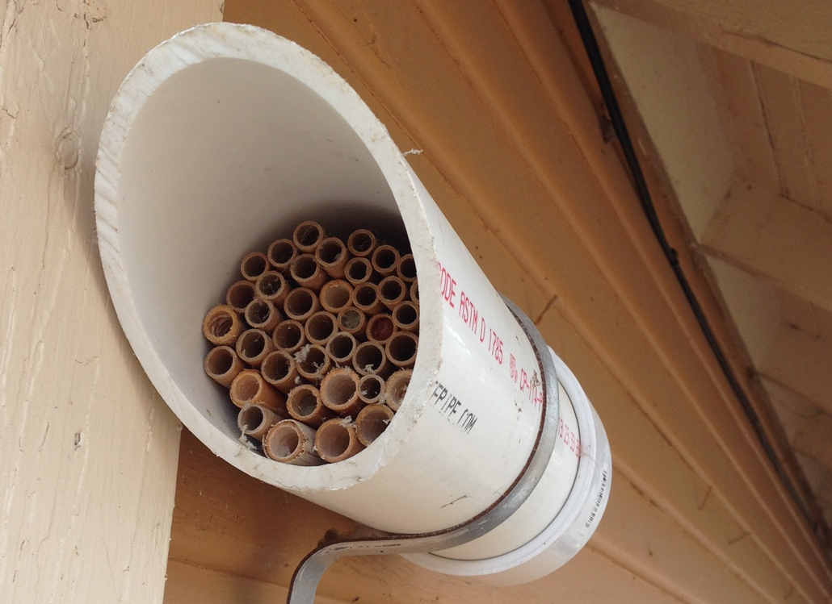
Place under the eaves of you house with the front facing east.
The best location to put the nesting house is some where it will receive morning sun and afternoon shade.
Female bees are more likely to use nesting holes that face the morning sun.
You will leave this up until late fall. In the hotter months the dormant bees need shade to protect them from the hot afternoon sun.
Under the eaves works well for shade and also rain protection.

Slide 14
Give the Mason bees access to mud
In the early spring when the Mason bees are active you should give them access to some mud. The closer to the nesting house they can find mud the less time they will have to spend and therefore they can spend more time collecting pollen.

